Slide 1
CAPSTONE PROJECT
Adjustable Phone / Tablet Stand
A Design Engineering Internship Capstone — CAD, Design Calculations & Engineering Drawing
Nimrah Saleem
Department of Electronic Engineering, NED University of Engineering & Technology

Slide 2
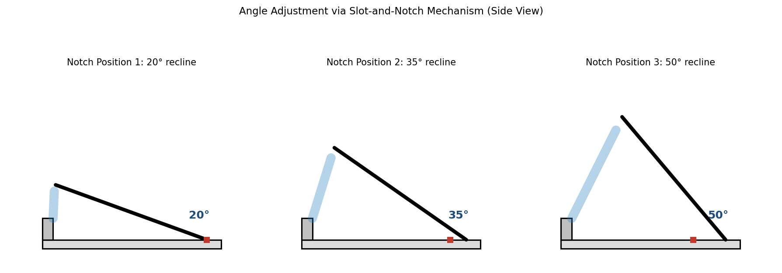
Agenda
01
Problem & Objective
Why an adjustable stand, and what it needs to do
02
Design & Mechanism
The slot-and-notch angle adjustment concept
03
CAD Model & Drawings
Three selectable viewing angles: 20° / 35° / 50°
3D views and fully dimensioned engineering drawing
04
Calculations
Verifying stability so the stand never tips
05
Build & Reflection
Assembly steps and what this internship taught me
Design Engineering Internship — Capstone Project
02

Slide 3
Objective
THE PROBLEM
A phone or tablet needs different viewing angles for different tasks — but most stands only offer one fixed position.
Design and build a simple, tool-free adjustable stand that:
Supports at least 2–3 distinct viewing angles
Holds the phone/tablet securely without slipping
Remains stable and does not tip at any angle
Is simple enough to build with basic tools
Video calls, watching videos, and reading all need a different recline — and the stand must never tip over.
This capstone applies CAD modeling, design calculations, and engineering drawing — skills built across Weeks 1–3 — to one complete, independently designed project.
Design Engineering Internship — Capstone Project
03

Slide 4
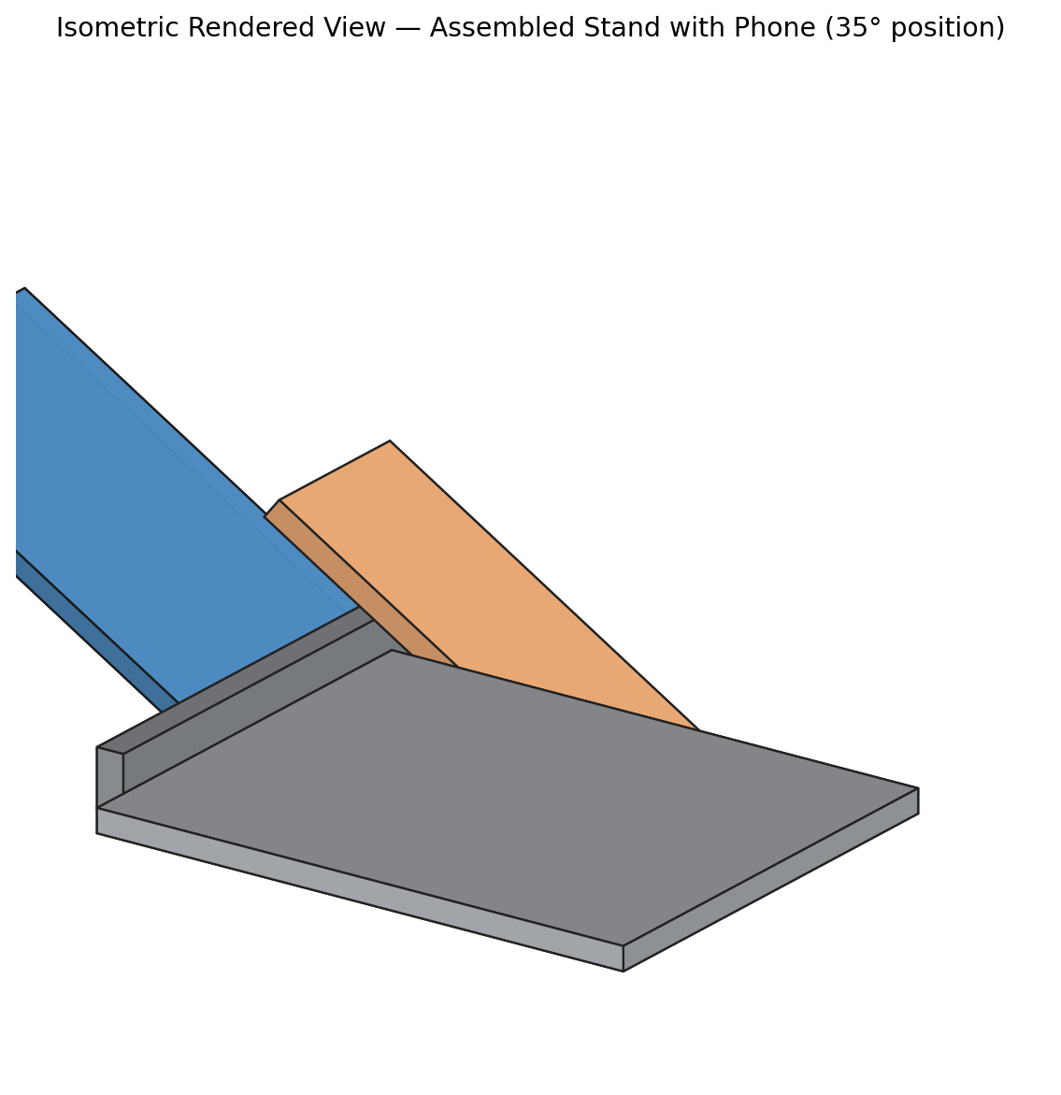
Proposed Design
A two-part slot-and-notch mechanism — no screws, hinges, or springs needed
Base Plate
Flat platform with a raised front lip to stop slipping, and a slot in the middle.
Back-Leg
Flat panel with a tab and three notches that lock the recline angle when inserted into the slot.
35°
Moving the leg's tab between notch 1, 2, or 3 changes the angle to ~20°, 35°, or 50° — a simple, tool-free adjustment.
MID POSITION
(default)
Design Engineering Internship — Capstone Project
04

Slide 5
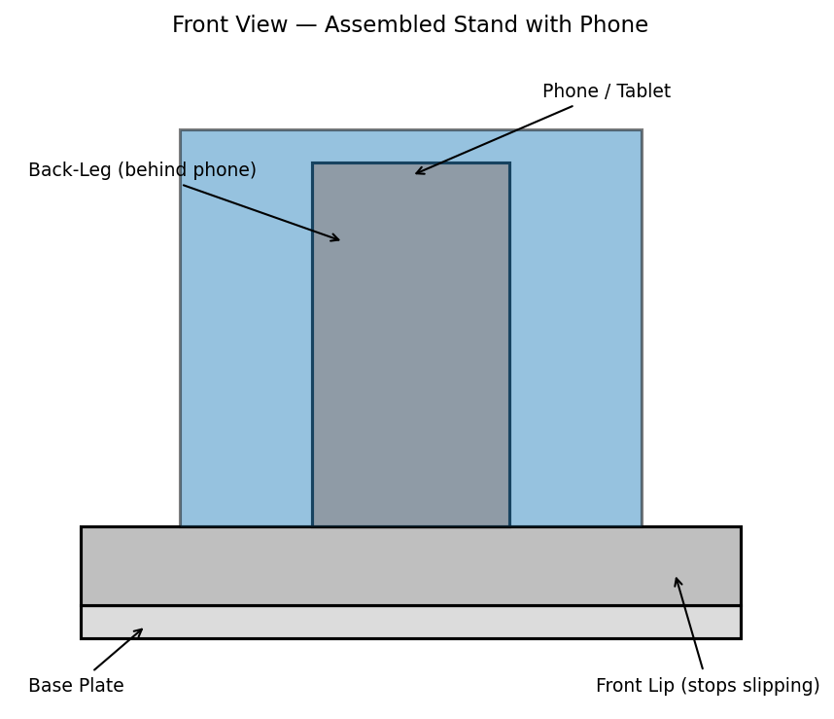
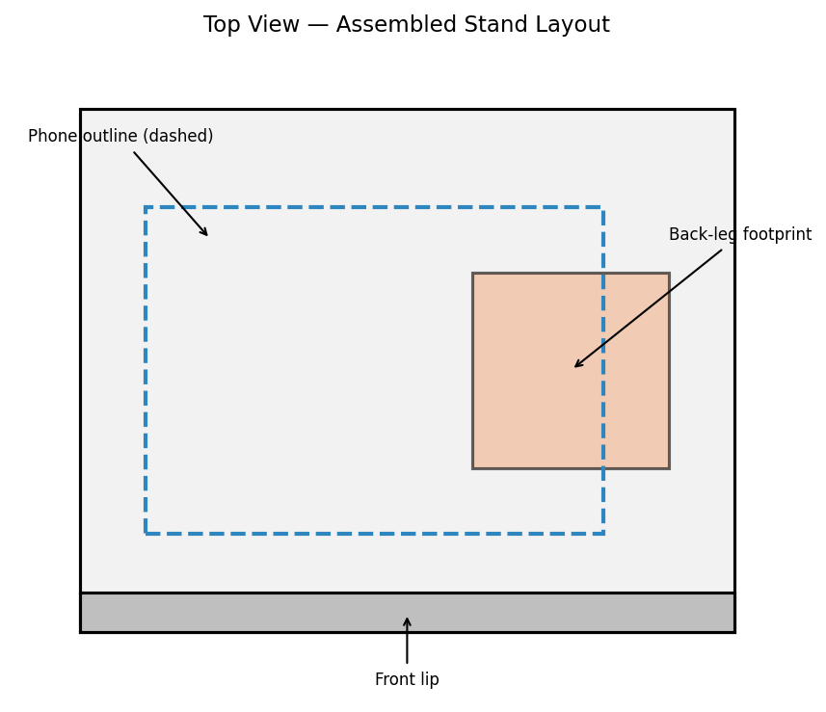
CAD Model — Multiple Views
The design was checked from every angle before finalizing the drawings
Front View
Top View
Isometric View
Design Engineering Internship — Capstone Project
05

Slide 6
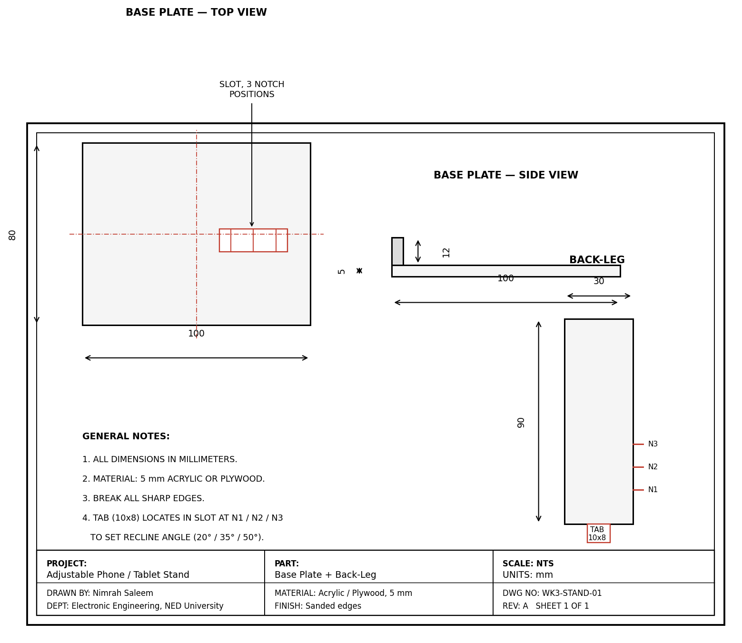
Engineering Drawing
Fully dimensioned drawing sheet with title block — all measurements in millimeters
Design Engineering Internship — Capstone Project
06

Slide 7
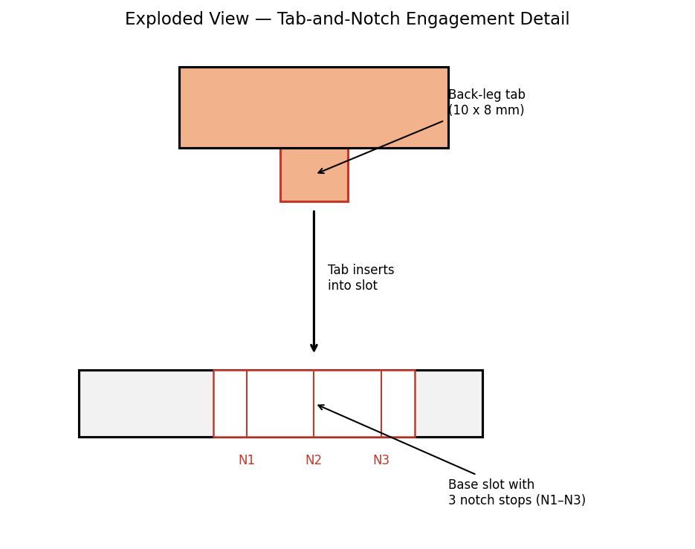
Mechanism Detail
The back-leg's tab (10×8 mm) slides into the base slot and locks against one of three notch stops — N1, N2, or N3 — to set the recline angle.
N1
20° — low, typing-friendly angle
N2
35° — default video-call position
N3
50° — steep, video-watching angle
Design Engineering Internship — Capstone Project
07

Slide 8
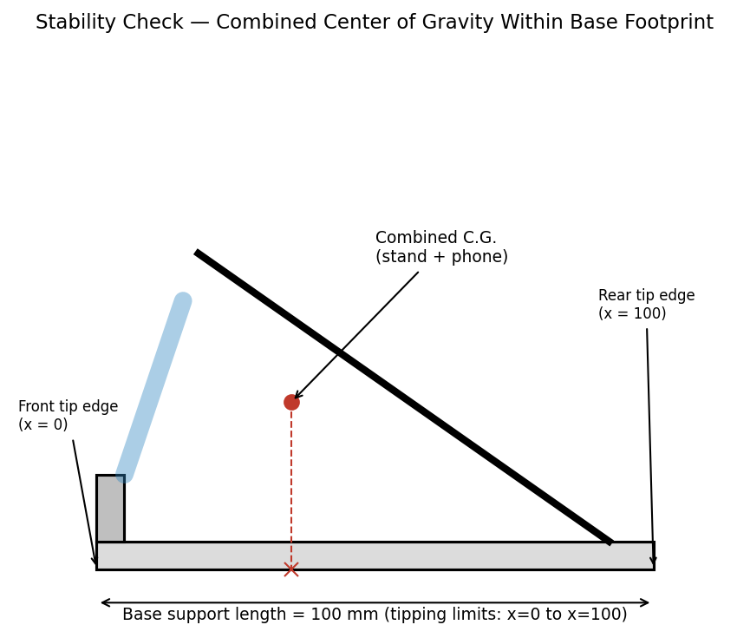
Design Calculations — Stability Check
Verifying the stand will not tip over at any of its three angles
100 mm
1.875 W
30–40 mm
Base footprint length
Total est. load w/ 25% margin
Combined C.G. position (all angles)
Stability condition
The combined center of gravity of stand + phone must stay between x = 0 (front) and x = 100 mm (rear) at every angle, or the stand tips.
Result: at 20°, 35°, and 50°, the C.G. stayed well within range — confirming the design is stable at every position.
Design Engineering Internship — Capstone Project
08

Slide 9
Build & Assembly
From drawing to finished, tested stand
Cut the base plate and back-leg from 5 mm acrylic or plywood per the drawing.
Cut the slot in the base and the three notches on the leg edge.
1
2
Sand all edges smooth, especially the phone-contact edge.
Insert the tab at notch 1 and check the phone sits securely.
3
4
Repeat for notch 2 and notch 3, confirming no tipping or wobble.
Test with the actual phone/tablet under real use.
5
6
Design Engineering Internship — Capstone Project
09

Slide 10
Design Justification
Independent decisions made during this capstone, and why
1
2
3
Slot vs. Hinge
3 Fixed Notches
100 mm Base Length
Chose a tab-and-slot mechanism over a hinge to avoid screws, springs, or extra hardware — simpler to build and more durable for a first project.
Chose fixed positions over continuous adjustment to keep the mechanism simple while still covering low, medium, and high viewing angles.
Sized the base specifically so the combined C.G. stays well within the footprint even at the steepest 50° angle — prioritizing stability.
Design Engineering Internship — Capstone Project
10

Slide 11
Reflection — What I Learned
Four weeks, one continuous skill-building arc
W1
W2
W3
W4
Fundamentals
Hands-On Practice
Mini Project
Capstone
Learned the CAD → calculations → drawings workflow and set up my design environment.
Modeled a guided bracket exercise, reinforcing sketch-based feature creation.
Designed an adjustable stand independently — my first end-to-end mechanical design.
Polished the Week 3 design into a complete, presentation-ready engineering package.
Design Engineering Internship — Capstone Project
11

Slide 12
Thank You
Questions & Discussion Welcome
Nimrah Saleem | Design Engineering Internship | NED University

